Slide 1
Daily Review – Mixtures
A solution is a mixture where one substance dissolves in another.
A suspension is a mixture where a substance doesn’t dissolve in a liquid and sinks to the bottom.
A colloid is a suspension that doesn’t separate over time.
Divide your whiteboard into 3 sections.
Use the headings solution, colloid, and suspension.
Put the following mixtures under the correct heading:
Fog Milk Seawater
Sugar in water Dirty water Oil in salad dressing

Slide 2
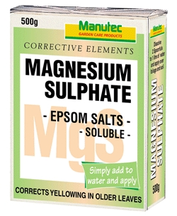
Daily Review
Which technique?
A gardener has dissolved magnesium sulphate in water to fertilize their plants. They do not use all of the solution and hope to recover the magnesium sulphate as a solid. What separation technique would you suggest they use?
The mixture is a solution and the gardener wants to keep the solid, so they should use crystallisation.
Identifying a separation technique
1. If there is a mixture of liquids with different boiling points, and you want the one with the higher boiling point: evaporation 2. If there is a solution and you want the solute: crystallisation

Slide 3
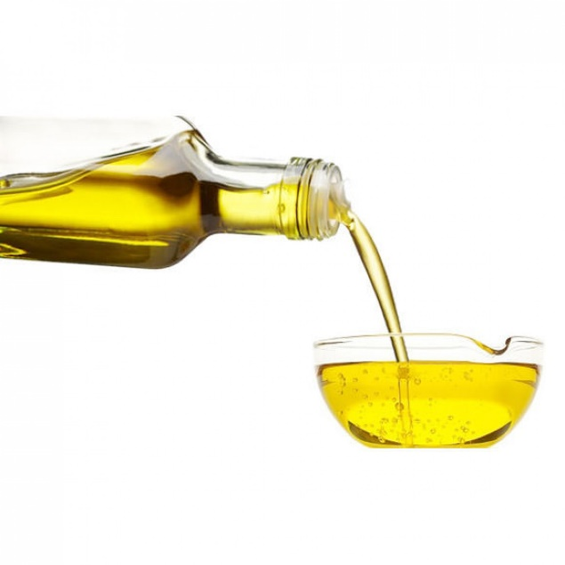
Daily Review
CFU 1
Which liquid needs to be kept: the one with the higher boiling point or the one with the lower boiling point?
Which technique?
A chef has accidentally mixed water into their bottle of olive oil. They need the oil for their new recipe but do not need the water. Water’s boiling point is 100 °C; the oil’s is 300 °C. Which separation technique do you recommend they use?
Identifying a separation technique
1. If there is a mixture of liquids with different boiling points, and you want the one with the higher boiling point: evaporation 2. If there is a solution and you want the solute: crystallisation
The chef wants to keep the liquid with the higher boiling point, so they should use evaporation.

Slide 4
Separating Mixtures: Magnetism and Density Year 7 Science

Slide 5
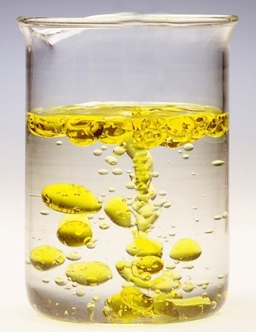
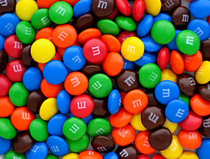
Learning Objectives
CFU
Which two things can be used to separate mixtures?
Explain how and when magnetism can be used to separate mixtures.
Define density.
Explain how and when density can be used to separate mixtures.
Activate Prior Knowledge
Think, Pair, Share: which one of these mixtures would be easier to separate? Why?

Slide 6
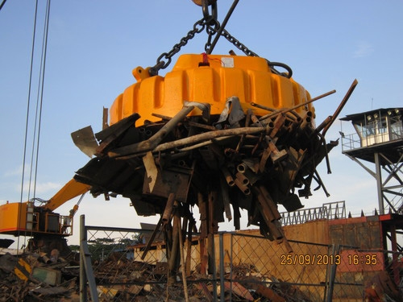
Concept Development
CFU 1
What word do we use to describe substances that are attracted to magnets?
Magnetic Separation
If a mixture contains magnetic substances, it can be separated using powerful magnets.
This is used in recycling plants to separate magnetic materials (e.g. iron, tin) from non-magnetic materials (e.g. paper, plastic).
CFU 2
Could you use magnetic separation to separate loose nails from scrap wood? Why or why not?
CFU 3
Could you use magnets to separate cardboard from paper? Why or why not?
Vocabulary
mag·net·ic (adjective) attracted to magnets

Slide 7
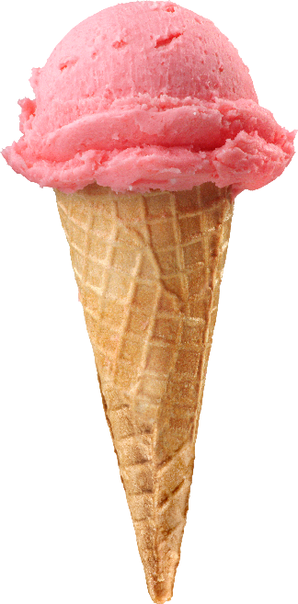
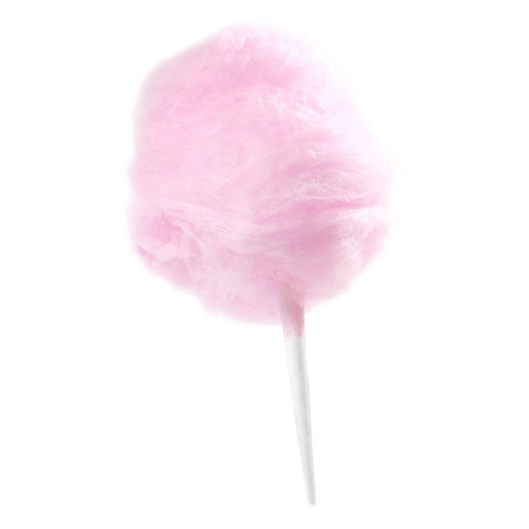
Concept Development
CFU 1
This fairy floss and this ice cream are the same size. Which one would be heavier? Why?
Using Density
Mixtures can also be separated based on their density.
Since ice cream is more dense (more tightly packed) than fairy floss, the same volume of it weighs more.
CFU 2
Which is more dense: ice cream or fairy floss?
Vocabulary
den·si·ty (noun) how tightly packed a substance is vol·ume (noun) the amount of space an object takes up

Slide 8
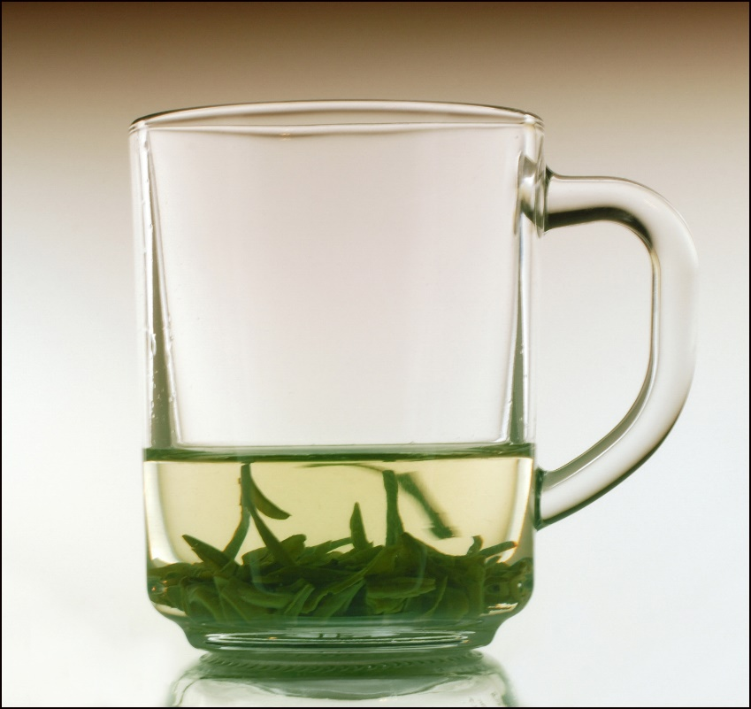
Concept Development
CFU 1
Without using any tools, how could you separate this mixture?
Using Density – Decanting
When a solid sinks to the bottom of a liquid, the liquid can then be poured out carefully, leaving the sediment behind.
CFU 2
Would magnetic separation work on this mixture? Why or why not?
Vocabulary
sed·i·ment (noun) solids that settle to the bottom of a liquid de·cant·ing (verb) pouring out a liquid, leaving the sediment behind

Slide 9
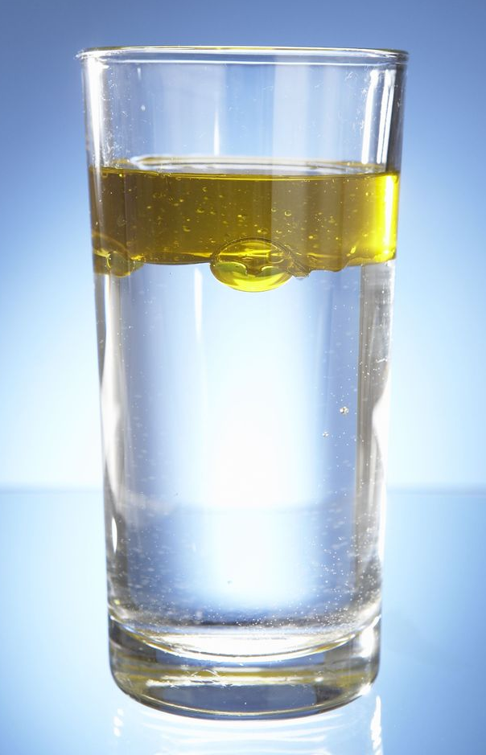
Concept Development
CFU 1
In this mixture, which substance is more dense? How do you know?
Using Density – Flotation
When substances sink to the bottom of a mixture, it is because they are more dense than the rest of the mixture.
A substance that is less dense than the rest of the mixture will float to the top.
These substances can then be separated by scooping them up.
CFU 2
In this mixture, which substance is less dense? How do you know?
Vocabulary
dense (adjective) tightly packed flo·ta·tion (noun) scooping up the substances floating on the top of a mixture

Slide 10

Skill Development/Guided Practice
CFU 1
Is one substance magnetic?
Which technique?
An oil spill has happened on the ocean. How could it be cleaned up?
CFU 2
Do the substances have different densities? Will one float or sink in water?
The oil floats on the water because it is less dense. It can be removed by using flotation.
Identifying a separation technique
1. If one substance is magnetic: magnetic separation 2. Do the substances have different densities? If one will sink in water: decanting If one will float in water: flotation
Vocabulary
de·cant·ing (verb) pouring out a liquid, leaving the sediment behind flo·ta·tion (noun) scooping up the substances floating on the top of a mixture

Slide 11
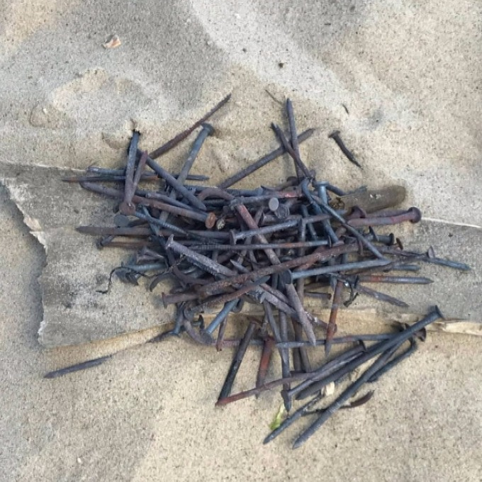
Skill Development/Guided Practice
CFU 1
Is one substance magnetic?
Which technique?
A builder dropped some nails in the sand. How could he separate them?
CFU 2
Do the substances have different densities? Will one float or sink in water?
The nails are magnetic and the sand is not, so he could use magnetic separation.
Identifying a separation technique
1. If one substance is magnetic: magnetic separation 2. Do the substances have different densities? If one will sink in water: decanting If one will float in water: flotation
Vocabulary
de·cant·ing (verb) pouring out a liquid, leaving the sediment behind flo·ta·tion (noun) scooping up the substances floating on the top of a mixture

Slide 12
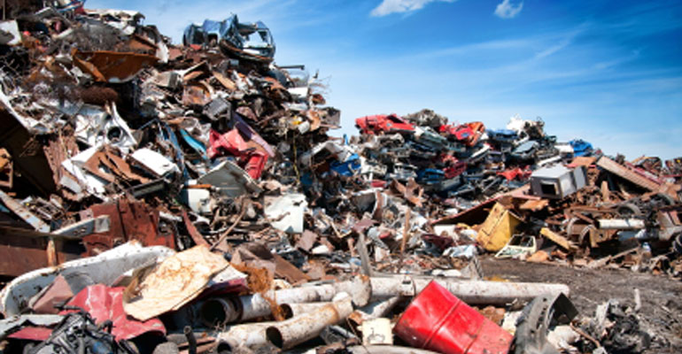
Skill Development/Guided Practice
CFU 1
Is one substance magnetic?
Which technique?
Separate the scrap metal from plastic at a recycling plant
CFU 2
Do the substances have different densities? Will one float or sink in water?
Identifying a separation technique
1. If one substance is magnetic: magnetic separation 2. Do the substances have different densities? If one will sink in water: decanting If one will float in water: flotation
Vocabulary
de·cant·ing (verb) pouring out a liquid, leaving the sediment behind flo·ta·tion (noun) scooping up the substances floating on the top of a mixture

Slide 13
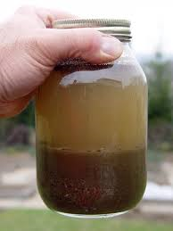
Skill Development/Guided Practice
CFU 1
Is one substance magnetic?
Which technique?
Separate the mud from the dirty water
CFU 2
Do the substances have different densities? Will one float or sink in water?
Identifying a separation technique
1. If one substance is magnetic: magnetic separation 2. Do the substances have different densities? If one will sink in water: decanting If one will float in water: flotation
Vocabulary
de·cant·ing (verb) pouring out a liquid, leaving the sediment behind flo·ta·tion (noun) scooping up the substances floating on the top of a mixture

Slide 14

Relevance
Magnetic separation is used in recycling plants.
Decanting is used in the production of wine and cream.
Floatation is used when cleaning up oil spills on the ocean.

Slide 15

Skill Closure
What sort of materials can be removed from a mixture by magnetic separation?
Mr Axtens drinks his tea carefully to avoid drinking the leaves at the bottom. Which separation technique is he using?
Why does oil float on water?
Which separation technique does this allow you to use?
Skill Closure
Skill Closure

Slide 16
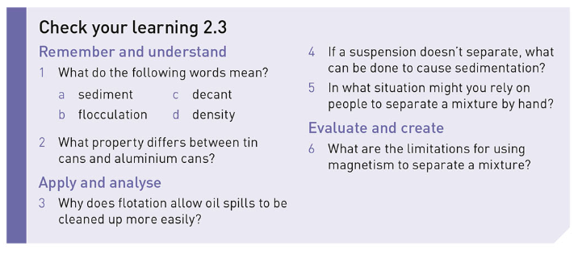
Independent Practice
Attempt Questions 1-6 on page 35 of the textbook.
Ignore questions 1b and 4 (or complete them as extension)
You might need to do some reading to answer question 2. (Hint: look at Figure 2.13.)

